Slide 1
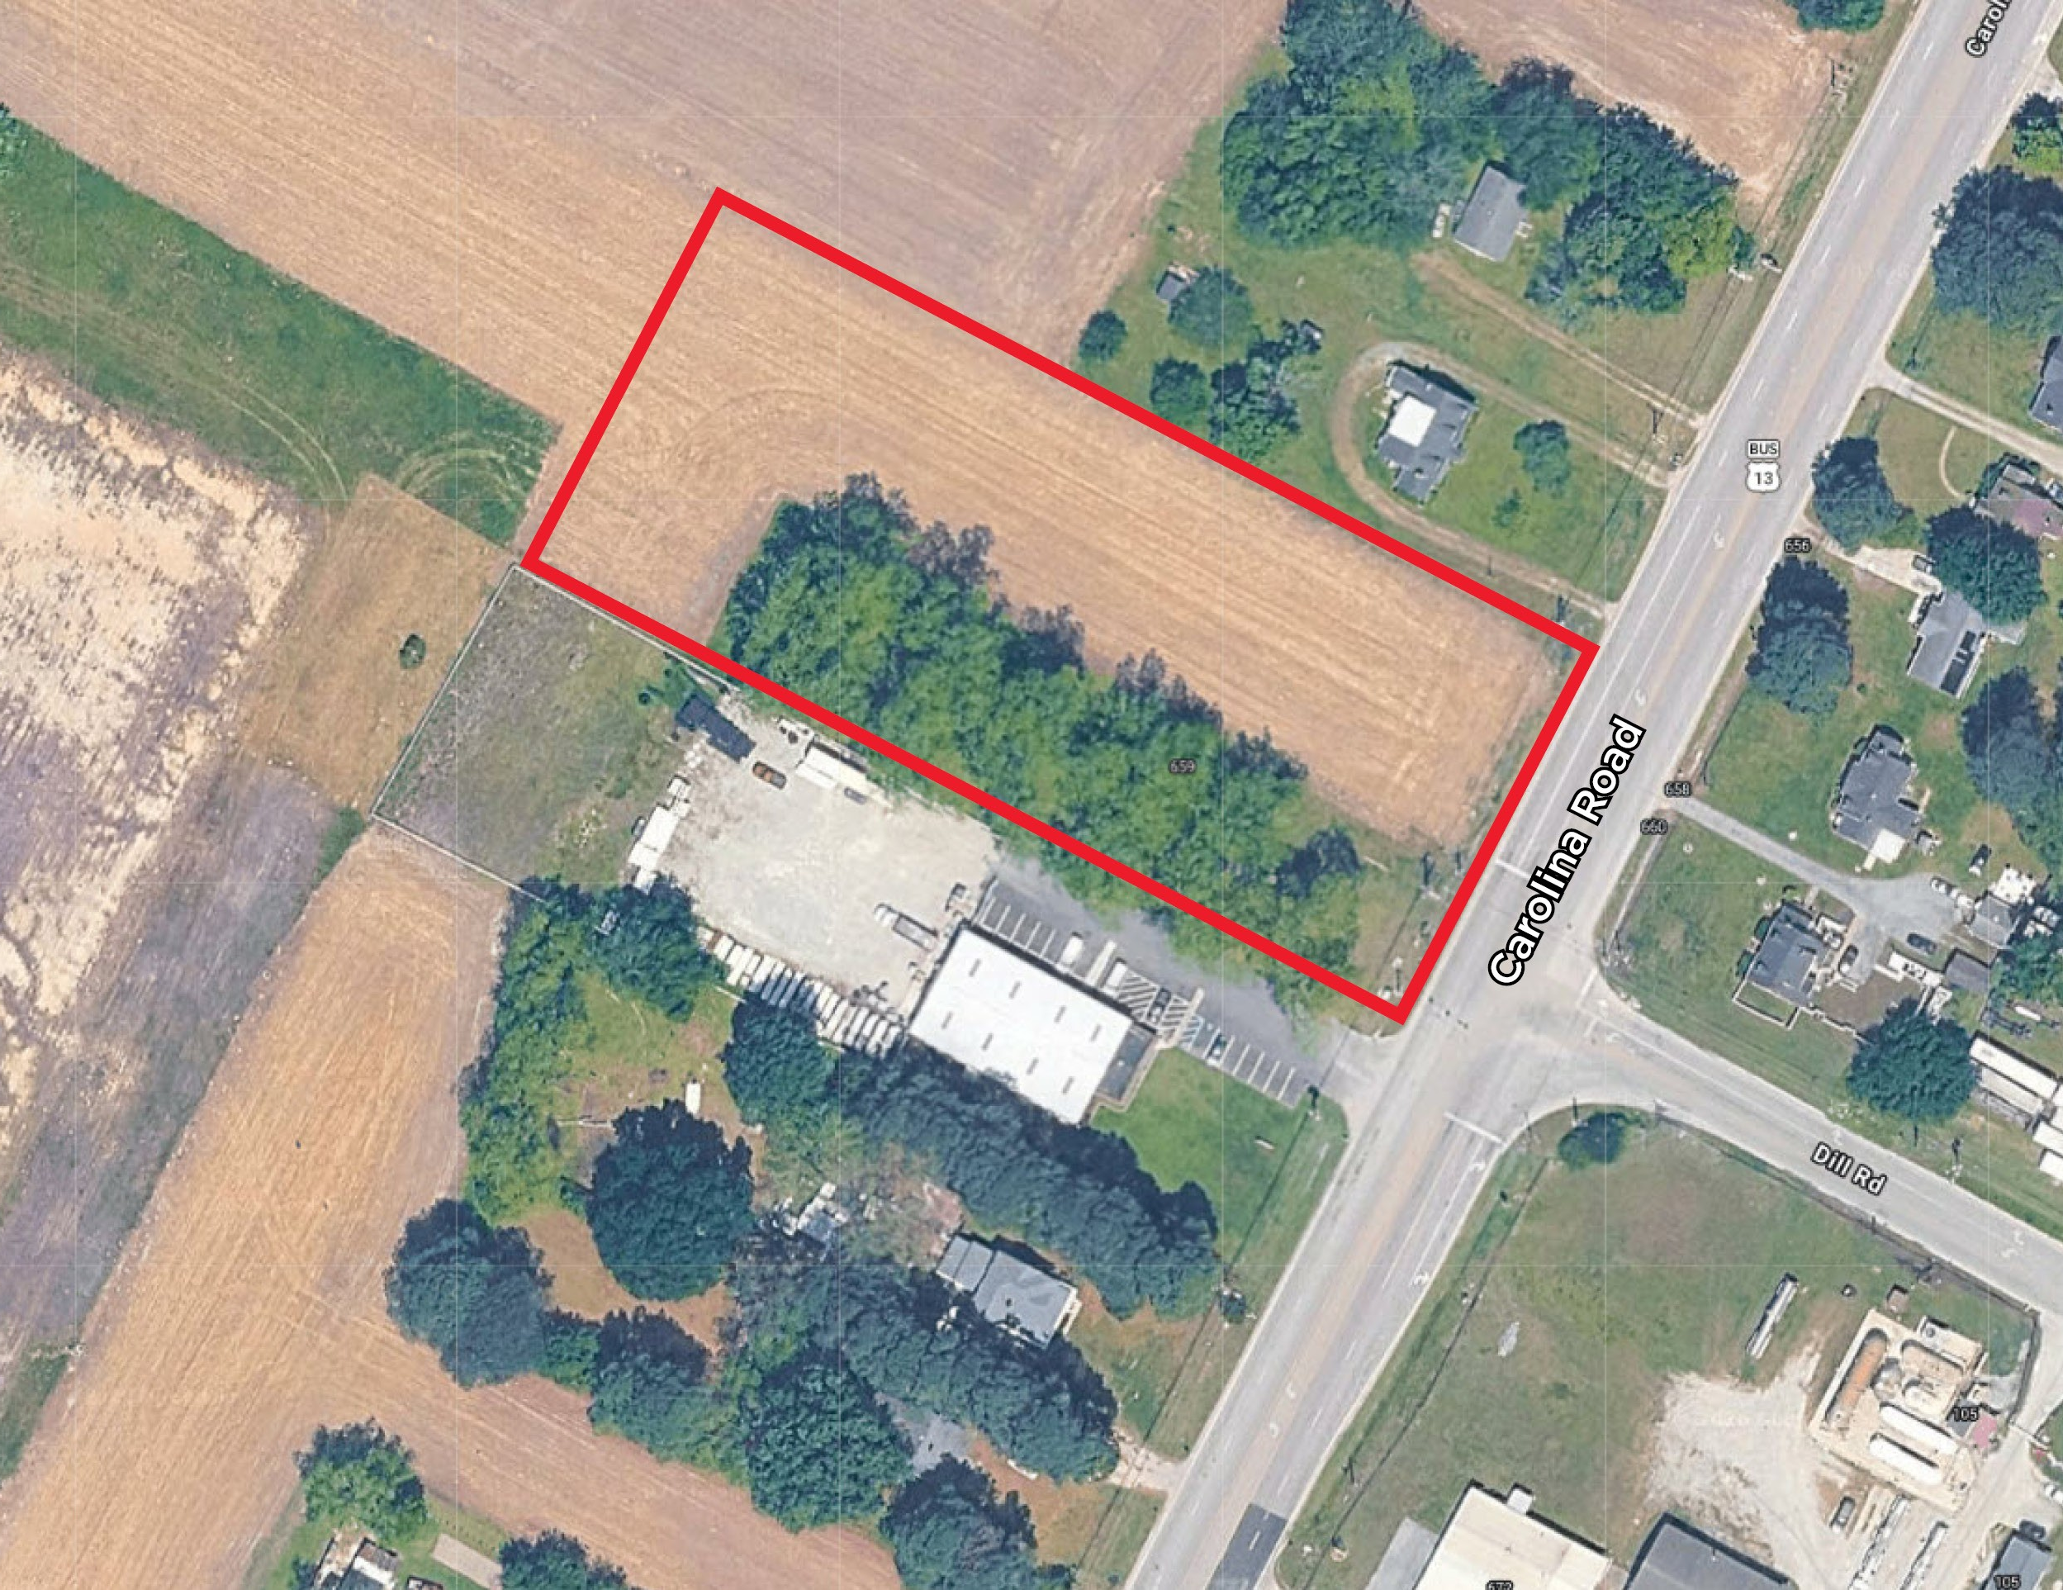
INDUSTRIAL LAND / ±2.5 ACRES
LAND LEASE OR BUILD-TO-SUIT
663 Carolina Road
Suffolk, VA 23434

Slide 2
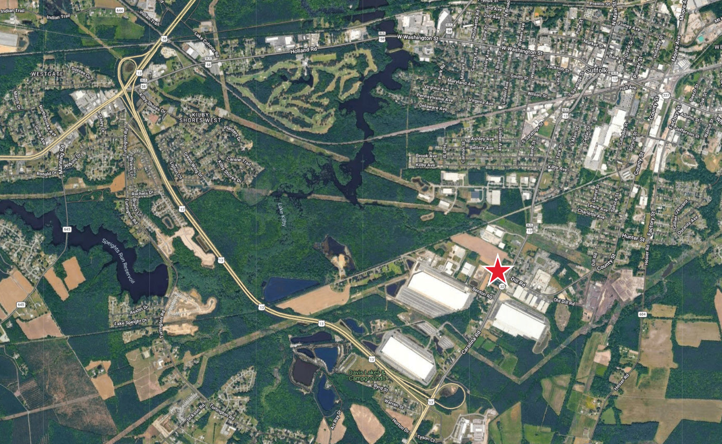

PROPERTY
FEATURES
±2.5 AC site
Zoned M-2
Available as Ground Lease or Build-to-Suit
Contact agent for more information

Slide 3









PROPERTY
LOCATION

Slide 4

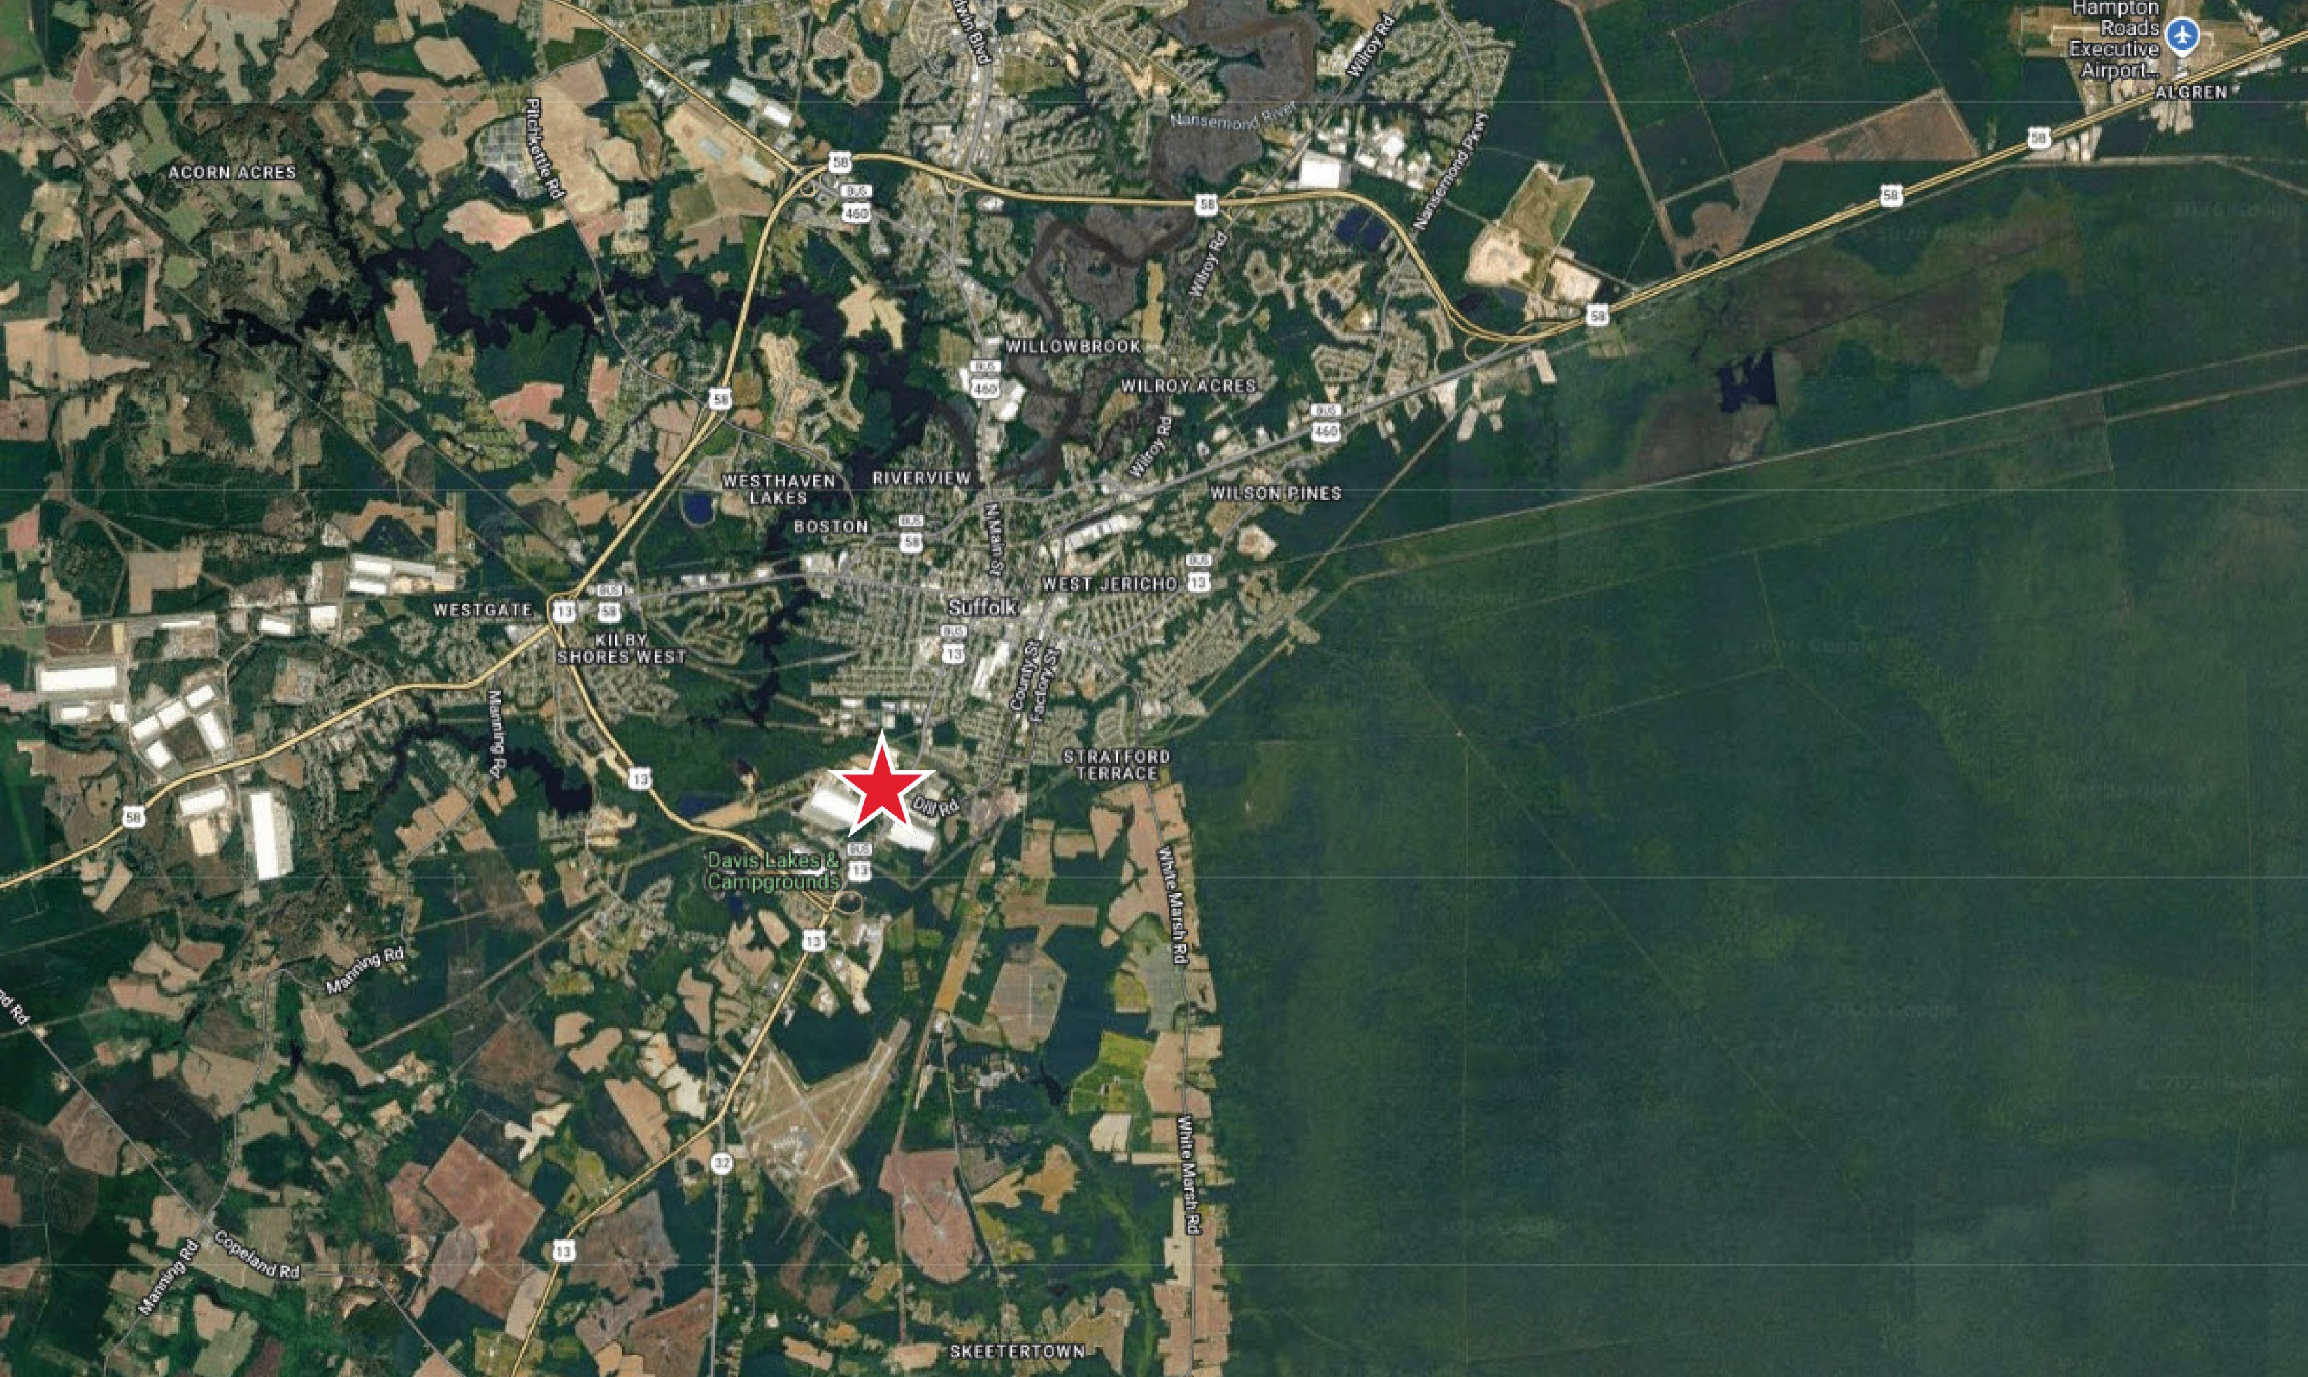
Thalhimer Center
11100 W. Broad Street
Glen Allen, VA 23060
thalhimer.com
Danny Holly
Senior Vice President
804 697 3552
danny.holly@thalhimer.com
Independently Owned and Operated / A Member of the Cushman & Wakefield Alliance
Cushman & Wakefield | Thalhimer © 2026. No warranty or representation, express or implied, is made to the accuracy or completeness of the information contained herein, and same is submitted subject to errors, omissions, change of price, rental or other conditions, withdrawal without notice, and to any special listing conditions imposed by the property owner(s). As applicable, we make no representation as to the condition of the property (or properties) in question.

